Slide 1
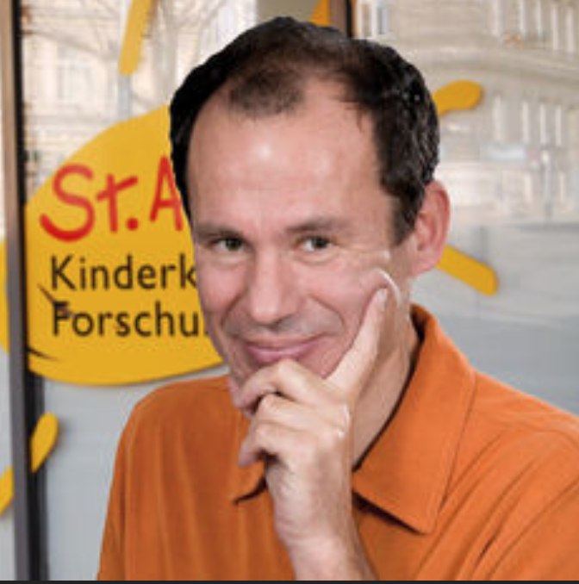
INVITED SPEAKER
PROF. HEINRICH KOVAR
St. Anna Kinderkrebsforschung
CHILDREN'S CANCER RESEARCH INSTITUTE VIENNA, Austria
Lnc-ing tumor susceptibility to translational stress response in Ewing sarcoma
WHEN
September 15, 2017
12:00 -12:45
WHERE
Room 90.78.100.029
MRB2, entrance 38, UZ Gent
Hosted by
Prof. Frank Speleman
Key references
Tomazou EM, Sheffield NC, Schmidl C, Schuster M, Schönegger A, Datlinger P, Kubicek S, Bock C, Kovar H. (2015) Epigenome mapping reveals distinct modes of gene regulation and widespread enhancer reprogramming by the oncogenic fusion protein EWS-FLI1. Cell Rep.10(7):1082-95.
Ban J, Aryee DN, Fourtouna A, van der Ent W, Kauer M, Niedan S, Machado I, Rodriguez-Galindo C, Tirado OM, Schwentner R, Picci P, Flanagan AM, Berg V, Strauss SJ, Scotlandi K, Lawlor ER, Snaar-Jagalska E, Llombart-Bosch A, Kovar H. (2014) Suppression of deacetylase SIRT1 mediates tumor-suppressive NOTCH response and offers a novel treatment option in metastatic Ewing sarcoma. Cancer Res. 74(22):6578-88.
Sheffield NC, Pierron G, Klughammer J, Datlinger P, Schönegger A, Schuster M, Hadler J, Surdez D, Guillemot D, Lapouble E, Freneaux P, Champigneulle J, Bouvier R, Walder D, Ambros IM, Hutter C, Sorz E, Amaral AT, de Álava E, Schallmoser K, Strunk D, Rinner B, Liegl-Atzwanger B, Huppertz B, Leithner A, de Pinieux G, Terrier P, Laurence V, Michon J, Ladenstein R, Holter W, Windhager R, Dirksen U, Ambros PF, Delattre O, Kovar H, Bock C, Tomazou EM. (2017) DNA methylation heterogeneity defines a disease spectrum in Ewing sarcoma. Nat Med. 23(3):386-395

