Slide 1
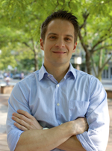
INVITED SPEAKER
dr. Denes Hnisz
Whitehead Institute for Biomedical Research
CAMBRIDGE, USA
Gene Dysregulation in Cancer: the View from Chromosome Neighborhoods
WHEN
February 15, 2018
12:00 -13:00
WHERE
Room 90.78.100.029
MRBII, UZ Gent
Hosted by
Prof. dr. Frank Speleman
Key publications: Hnisz et al., Science, 2016; Mol Cell 2015; Cell 2013

