Slide 1
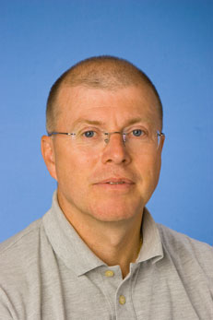



INVITED SPEAKER
PROF. Bengt Hallberg
Department of Medical Biochemistry and Cell biology Institute of Biomedicine
GotheNbUrg, Sweden
ALK in cancer biology
WHEN
February 1st, 2018
12:00 -13:00
WHERE
Room 90.78.100.029
MRBII, UZ Gent
Hosted by
Prof. Frank Speleman

